Slide 1
Bank Loan Case Study
By Prasoon Bisht

Slide 2
Project Description
In this project we are given two dataset, one containing the current details of the client at the time of application and other contains the information about the client’s previous loan data. We have to give the visualization and summarize the important results in the presentation.
The work file contains four files- application_data, ,merged_dataset and merging(jupyter notebook file) and Bank Loan Case Study pdf.

Slide 3
Tech-Stack Used
Microsoft Excel is for making the graphs and charts for the problems provided. We have used excel because it is very easy to do statistical operations and charts and graphs are just few clicks aways.
Jupyter Notebook is used for reading and cleaning the second (previous application) dataset. The merging of both the dataset was also done on the jupyter notebook as the number of rows in this dataset exceeds the limits of Microsoft Excel and then the analysis was done on Microsoft Excel.
Excel file link:
https://docs.google.com/spreadsheets/d/1qLj95AXBedc-zvirTQHXjH-uUumMqo6p/edit?usp=share_link&ouid=103023370670747143533&rtpof=true&sd=true
https://docs.google.com/spreadsheets/d/10K4kiE5IpegoHxU1BH-TT3_e5ktYxZED/edit?usp=share_link&ouid=103023370670747143533&rtpof=true&sd=true

Slide 4
Approach
Present the overall approach of the analysis. Mention the problem statement and the analysis approach briefly.
Indentify the missing data and use appropriate method to deal with it. Finally we are left with very few blank cells. For dealing with them, we either use mean or median are used. We have used median in our dataset as there we outliers present in the dataset.
Understanding the dataset carefully.
Find the blank cells and then cleaning them.
“COUNTBLANK” function was used to count the number of blank cells in each column.
Columns containing more number of blank cells were deleted.
Columns that has less number of blank cells are left.

Slide 5
As the dataset is large deleting few rows the have blank cells will not affect the analysis process. So, some blanks cells rows have been deleted.
For filling the blank cells that are left we have to choose between mean, median and mode. For this purpose, we first check the outliers. In column “AMT_ANNUITY” we checked for outliers and found that there were too many outliers. So, we used “median” to fill the blank cells.
Our final dataset for analysis is now ready.
Charts were created using pivot table and pivot chart option and the correlation was calculated with the help of “Data Analysis” option in the “Data tab”.

Slide 6
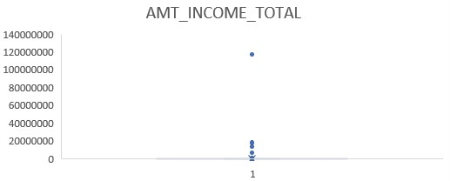
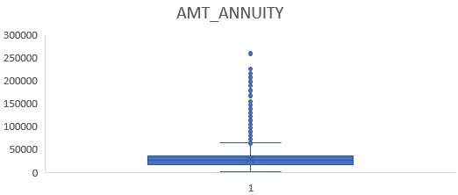
Identify if there are outliers in the dataset. Also, mention why do you think it is an outlier. Again, remember that for this exercise, it is not necessary to remove any data points.
Any value that is much larger or smaller than the most of the values is considered an outlier and the best way to detect outliers is by visualization through different graphs (e.g., scatter plot, box plot etc.). Every point outside the maximum and minimum value in a box plot is considered an outlier. The below figures shows the same for different columns.
In AMT_INCOME_TOTAL all the values greater than 3,60,000 are considered outlier and in AMT_ANNUITY column all the values greater than 63,434.3 are considered outliers.

Slide 7
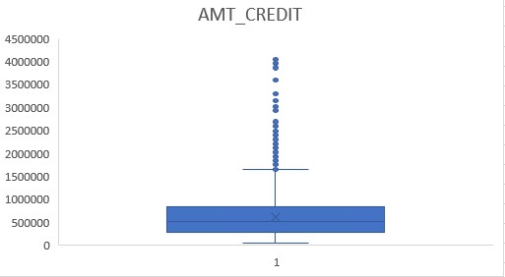
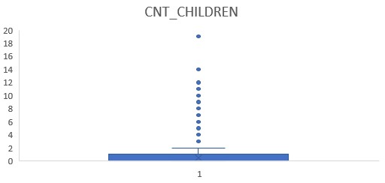
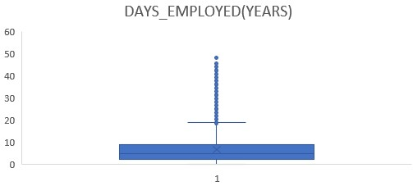
In AMT_CREDIT, CNT_CHILDREN and DAYS_EMPLOYED(YEARS) all the values greater than 16,56,106, 2.5 and 18.6 respectively are considered outliers.
These values are considered outliers because these values are much greater than most of the values in the columns.

Slide 8
Identify if there is data imbalance in the data. Find the ratio of data imbalance.
Data imbalance ratio is the ratio between count of one value to the other value.
Column Name | Data Imbalance Ratio
Target | 10.55
Contract Type | 8.75
Own Car | 0.60
Own Realty | 2.11

Slide 9
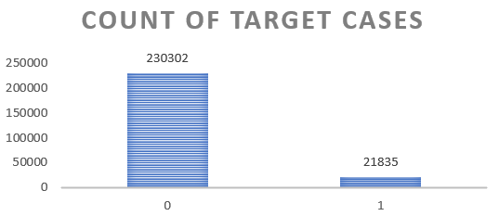
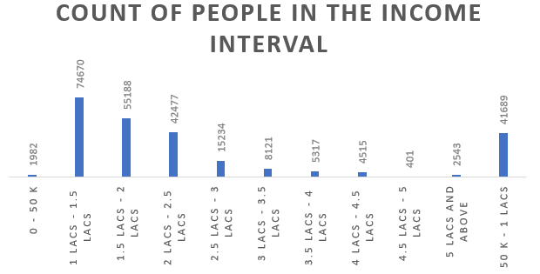
Explain the results of univariate, segmented univariate, bivariate analysis, etc. in business terms.
Univariate Analysis-
The first graph shows that clients with payment difficulties are 21,835 and the left clients are the other cases.
The second graph shows that most of the people fall in the income range from 1 lakh to 1.5 lakh.

Slide 10
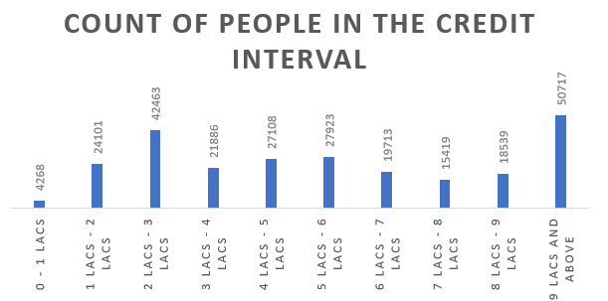
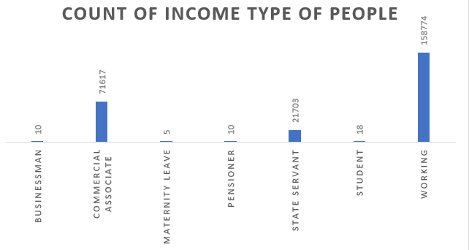
The first graph above shows that most clients have applied for a loan above 9 lakhs.
The second graph shows that most people are in working income type.

Slide 11
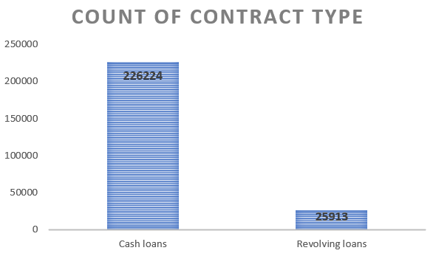
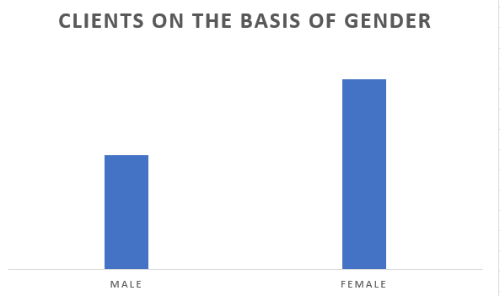
The FIRST graph shows that most clients have taken cash loans.
The second graph shows that female clients are more than male clients.

Slide 12
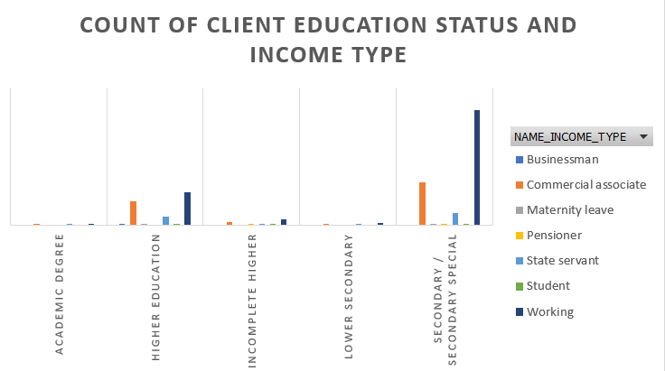
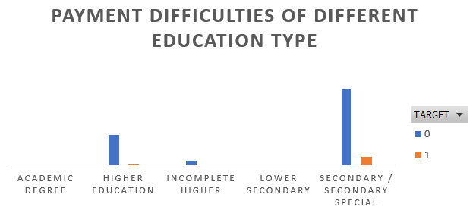
Bivariate Analysis-
The first graph shows that clients with secondary/secondary special education type and income type as working has taken the most number of loans.
The second graph shows that very less ratio of the client faced payment difficulties as compared to the total clients in the secondary/secondary special education type.

Slide 13
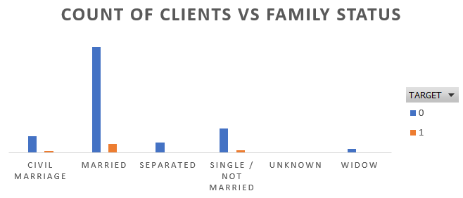
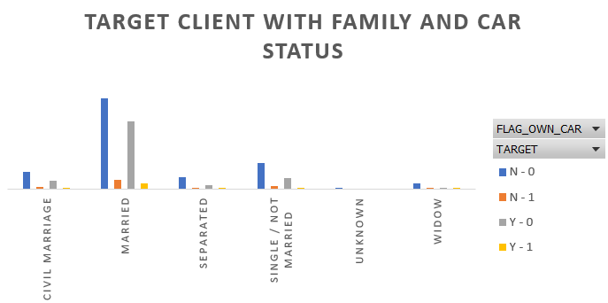
The first graph shows that most clients are married and very less among them faces payment difficulties.
The second graphs shows that most married clients does not own car and very less who owns car faces payment difficulties.

Slide 14
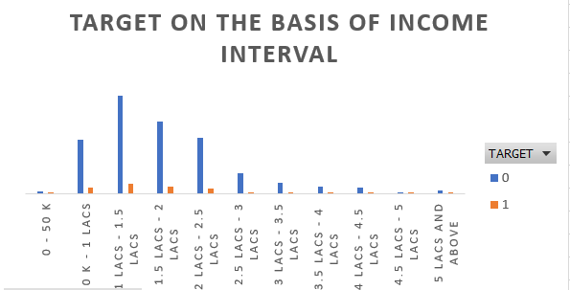
The most cases which do not have difficulty in paying comes under the income interval of 1 lakh to 1.5 lakh.

Slide 15
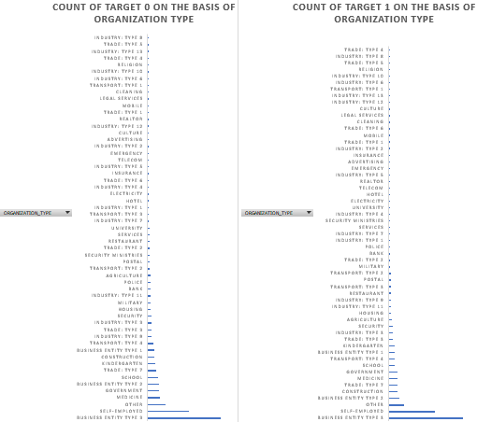
The graphs shows that most clients fall in the organization type of Business Entity Type 3 and Self Employed in both Target 0 and Target 1.

Slide 16
Analysis on Combined dataset
The Cash Loan is 94.14% and Revolving is 5.86% of total loans taken.
Among Cash loans, 13.99% faces payment difficultly whereas 86.01% are other cases..
Among Revolving loans, 7.76% faces payment difficulty whereas 92.24% are the other cases.
Here the numbers can be misleading as the number of revolving loan applications are very less than cash loan applications.
The most number of loans are Cash loans with no payment difficulty.

Slide 17
The most number of loans were taken for repairs purpose and then for other purpose and most among them faced no difficulty.
The sum of amount credit is highest from repairs and the for others.

Slide 18
For Target 0 –
Previously, the largest sum of amount credit was 22.97% of the total sum for the income interval of 2-2.5 lakhs.
Currently, the most sum of credit is 22.74% of the total sum for the income interval of 1.5-2 lakhs.
For Target 1 –
The largest amount for previous and current applications are 24.52% and 24.31% for income interval of 1.5-2 lakhs.

Slide 19
Conclusion
Majority of client have applied for cash loans.
The number of loans and sum of amount credit is highest for repairs purpose.
Majority of clients with payment difficulties are in the interval of 1.5 – 2 lakhs.
Majority of the clients fall in the income interval of 1 – 1.5 lakh.
Majority of the clients are married.
Majority of the clients fall in the income type – working and education type – secondary/secondary special.
Majority of the clients have applied for credit more than 9 lakhs.
Applicants will higher salary were offered higher credit amount.

Slide 20
Correlation
Correlation is a statistical measure that expresses the extent to which two variables are linearly related (meaning they change together at a constant rate).
The correlation coefficient (r) is scaled so that it is always between -1 and +1. When r is close to 0 this means that there is little relationship between the variables and the farther away from 0 r is, in either the positive or negative direction, the greater the relationship between the two variables.

Slide 21
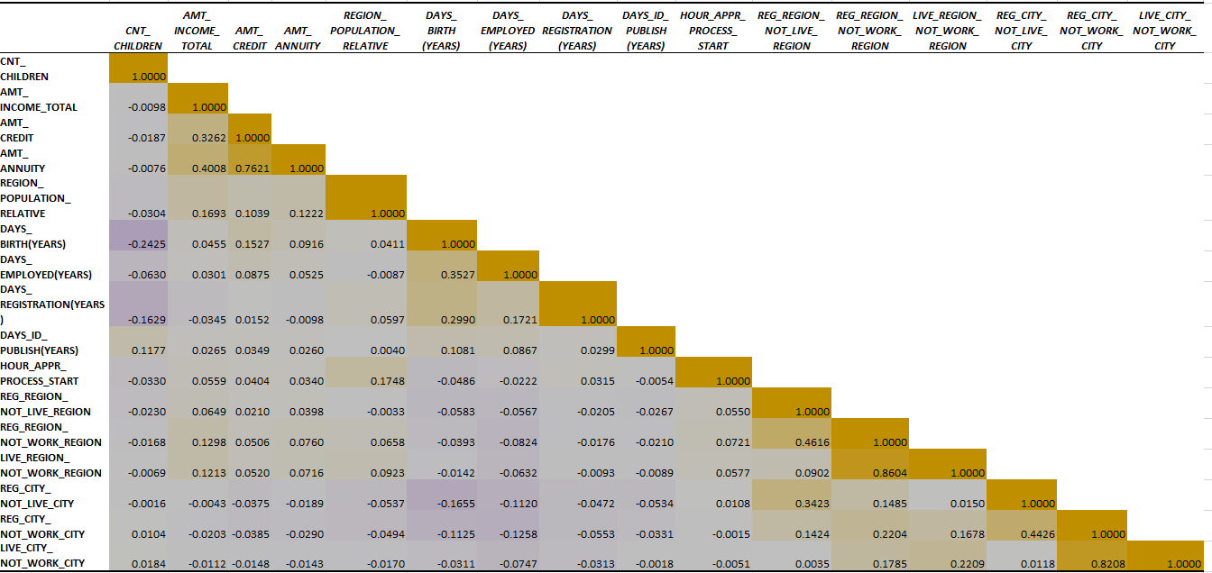
Find the top 10 correlation for the Client with payment difficulties and all other cases (Target variable).
Correlation for Target 0-
The most relevant correlations can be seen between AMT_ANNUITY and AMT_CREDIT, LIVE_CITY_NOT_WORKING _REGION AND REG_REGION_NOT_WORKING _REGION, LIVE_CITY_NOT_WORKING_REGION and REG_CITY_NOT_WORK_CITY.

Slide 22
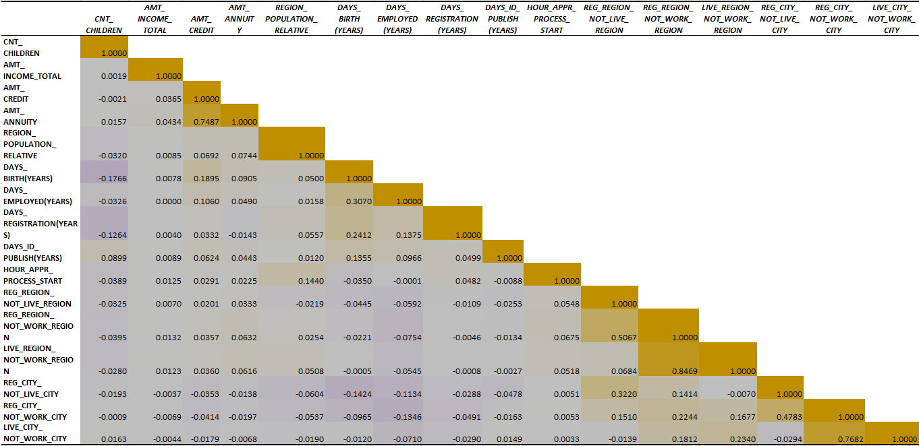
Correlation for Target 1-
The most relevant correlation can be seen between AMT_ANNUITY and AMT_AMOUNT_CREDIT, LIVE_REGION_NOT_WORK_REGION and REG_REGION_NOT_WORK_REGION, LIVE_CITY_NOT_WORK_CITY and REG_CITY_NOT_WORK_CITY, REG_REGION_NOT_WORK_REGION and REG_REGION_NOT_LIVE_REGION.

Slide 23
Results
In this project, I have learnt how to find the missing values in the data and how to remove the rows and columns.
I have learnt how to find outliers and based on that how to fill the values with mean, median and mode.
I have learnt how to do univariate, segmented univariate and bivariate analysis.
I have learnt about correlation, correlation heat map and how to relate different variables through correlation.
I have learnt how to visualize and present data.

